Slide 1
WEATHER ANALYSIS CAPSTONE PROJECT
SUBMITTED BY
A S ARUNDHATI ROUTRAY

Slide 2
WEATHER ANALYSIS CAPSTONE PROJECT
LOCATION ANALYSIS
HERE THE REGIONAL DIVERSITY AND FLUCTUATION OF DIFFERENT PARAMETERS CAN BE FOUND OUT.
HUMIDITY AND WEATHER ANALYSIS
THE VARIATION OF HUMIDITY AND WEATHER TYPES CAN BE ANALYSED AND COMPARED WITH OTHER PARAMETERS.
PERSPECTIVE
TEMPERATURE ANALYSIS
THE TEMERATURE CHANGE CAN BE ANALYSED AND COMPARED WITH OTHER PARAMETERS.
WIND DIRECTION AND SPEED ANALYSIS
THE WIND DIRECTION AND SPEED CAN BE ANALYSED AND COMPARED WITH OTHER PARAMETERS
GLOBAL COMPARISION
WE CAN COMPARE GLOBAL ENVIRONMENTAL PARAMETERS WITH OTHER DEVELOPMENTAL KEY INDICATORS.

Slide 3
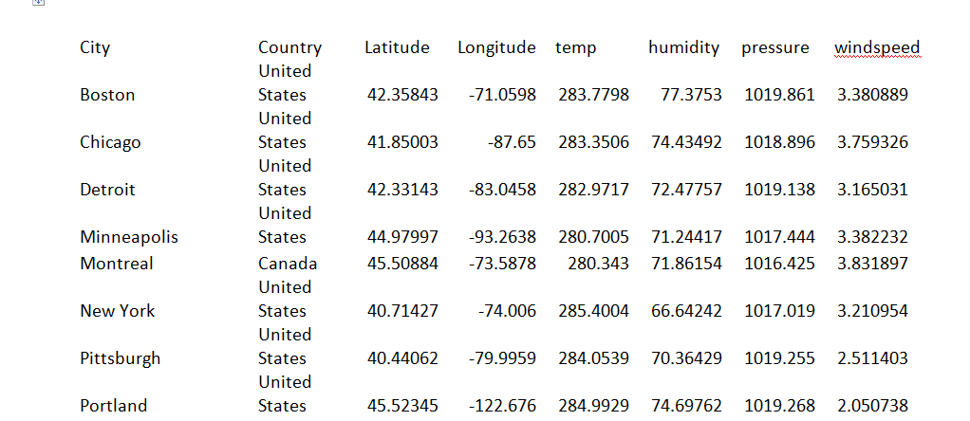
1.Are there any countries with cities located at extreme latitudes, and how might this impact their climate?

Slide 4
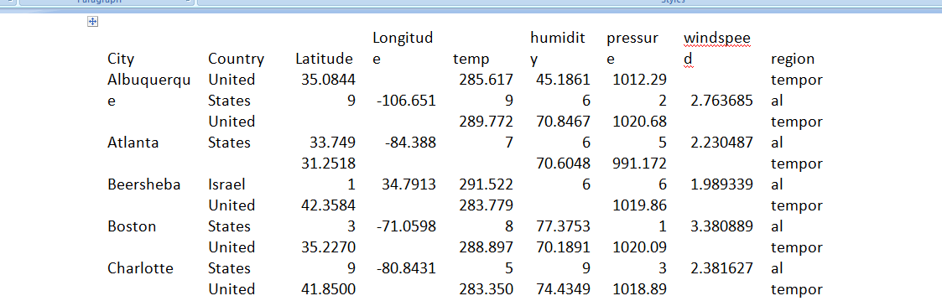
2
Can you identify any clusters of cities with similar latitude
and longitude values? What factors might explain these clusters?

Slide 5
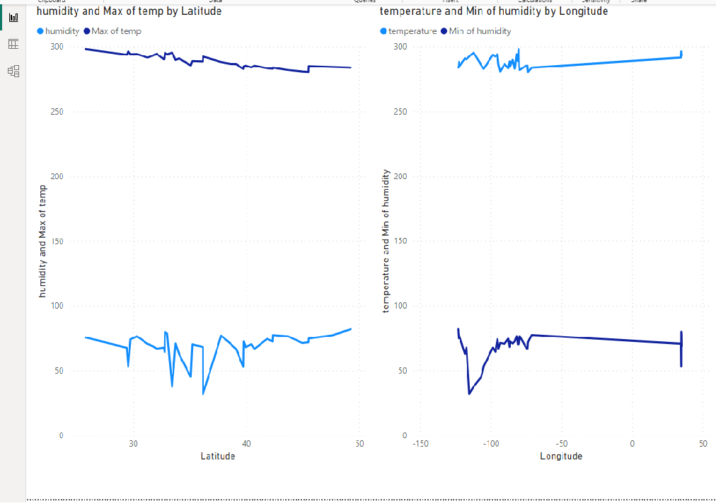
3
Are there any correlations between a city's geographical location
(latitude and longitude) and its weather attributes, such as
temperature or humidity?

Slide 6
Is there a correlation between humidity levels
and air pressure? How might this relationship
affect weather conditions?

Slide 7
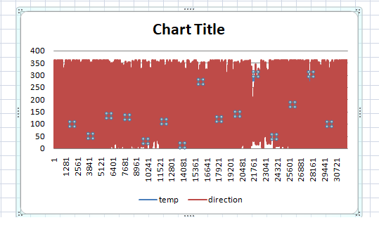
Explore the impact of wind direction on temperature for
coastal cities. Are there noticeable patterns?

Slide 8
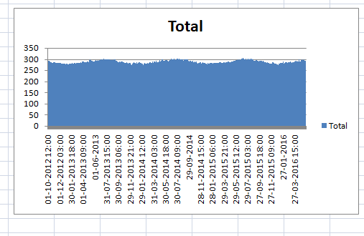
7Are there specific months when cities experience significant temperature
fluctuations?
What might explain these variations?

Slide 9
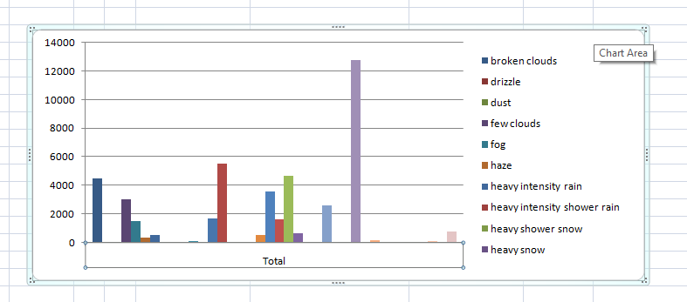
8Identify periods of extreme weather events, such as
storms or heatwaves, by analyzing the time-based data.
What patterns emerge?

Slide 10
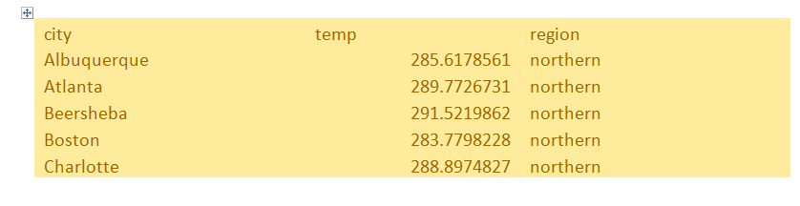
9.Are there any notable differences in temperature trends between northern and southern
hemisphere cities over the year? How do they relate to season

Slide 11
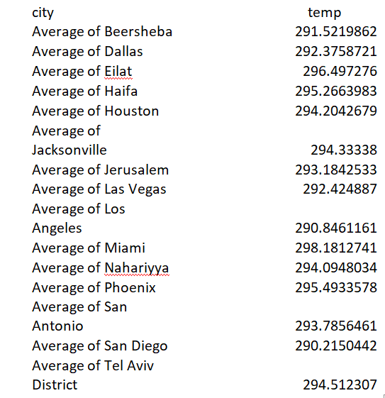
10What are the consequences of prolonged periods of extreme cold or
heat in specific cities?
How do residents adapt to such conditions?

Slide 12
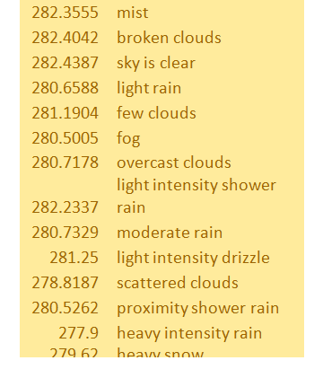
Investigate whether temperature anomalies (unusual deviations from the norm)
coincide with certain
events or environmental factors in specific cities.

Slide 13
12
Analyze the impact of temperature on energy consumption patterns in cities.
Are there noticeable trends or correlations?
As the temperature increases the energy consumption pattern increases.
13
How do specific wind patterns impact air quality and pollution dispersion in urban areas?
Analyze wind direction data for insights.
As the wind direction and speed increases the pollution and dispersion also increases.

Slide 14
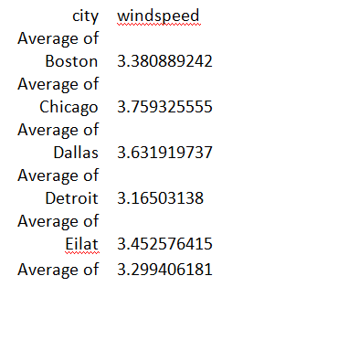
Identify cities prone to strong winds and the potential consequences,
such as increased risk of natural disasters or challenges for
transportation

Slide 15
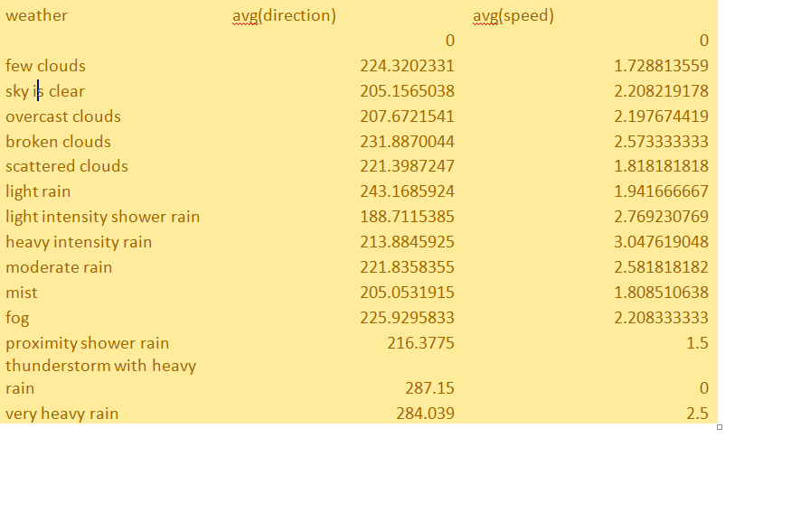
15.Explore whether wind speed and direction influence the
frequency and severity of weather-related events (e.g., hurricanes,
storms) in coastal cities.

Slide 16
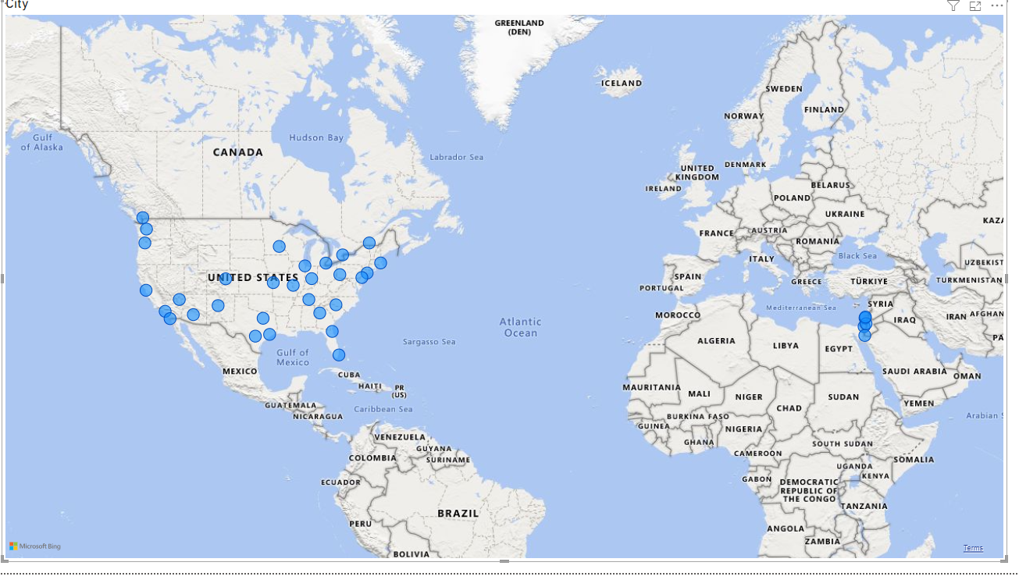
1.Can you create a geographical map in Power BI showing the distribution of cities in the dataset based on their latitude and longitude?

Slide 17
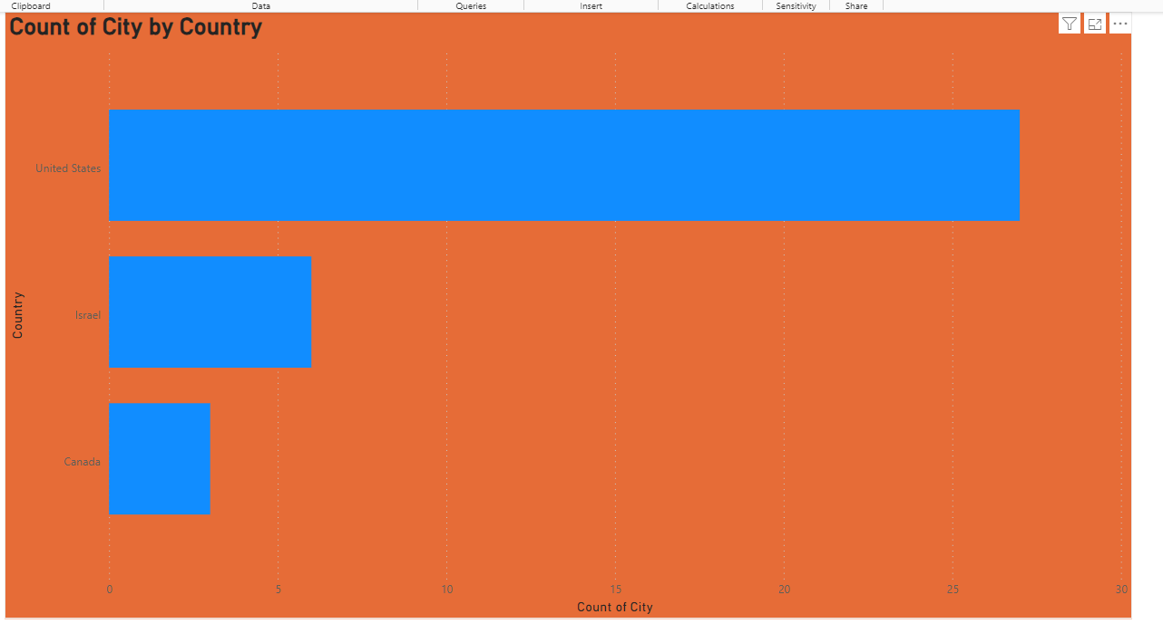
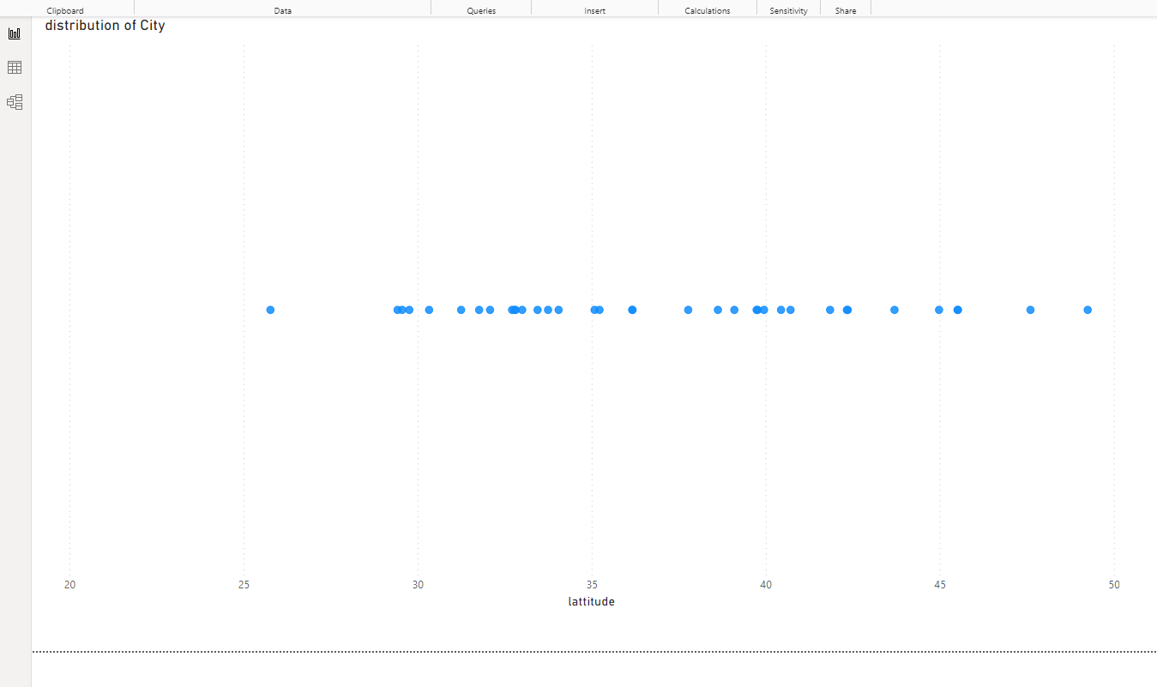
2.In Power BI, can you create a bar chart representing the top 10 countries with the highest number of cities in the dataset?
3.How does the distribution of cities in terms of latitude vary across different continents? Create a scatter plot in Power BI to illustrate this.

Slide 18
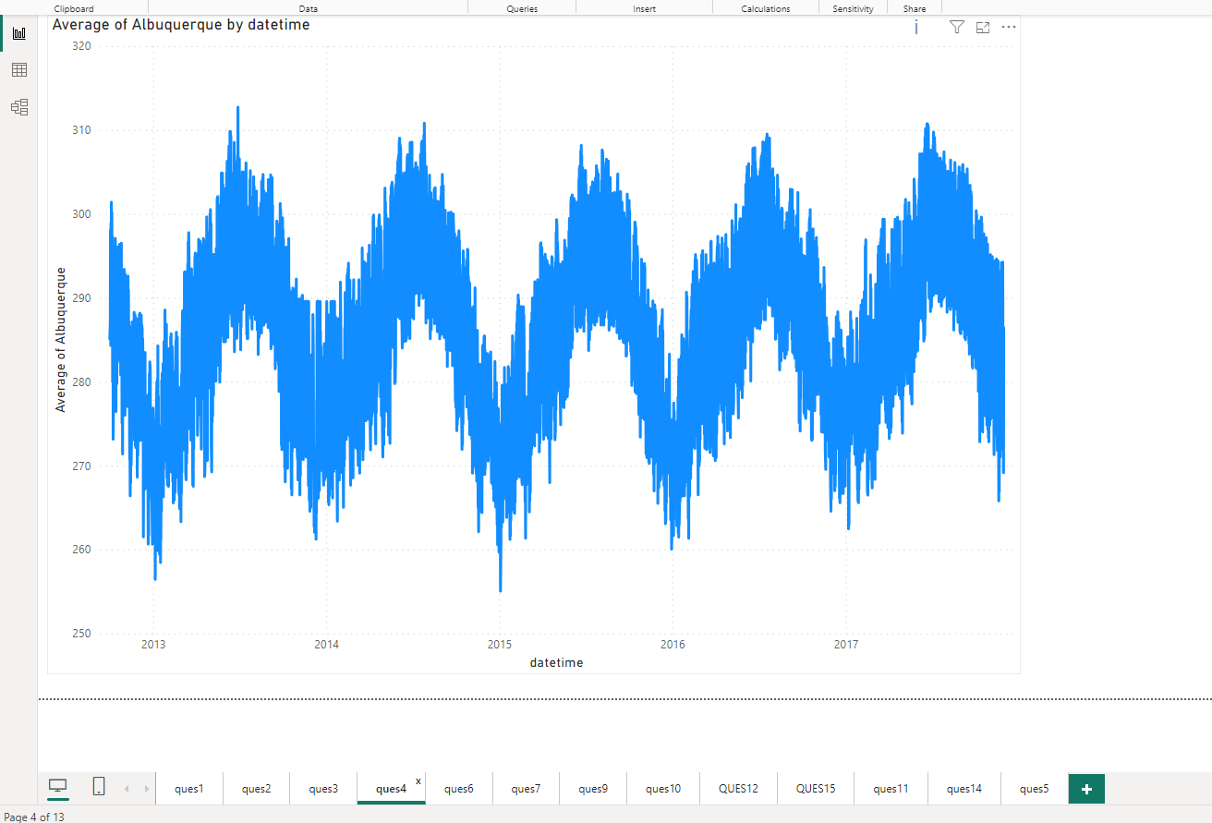
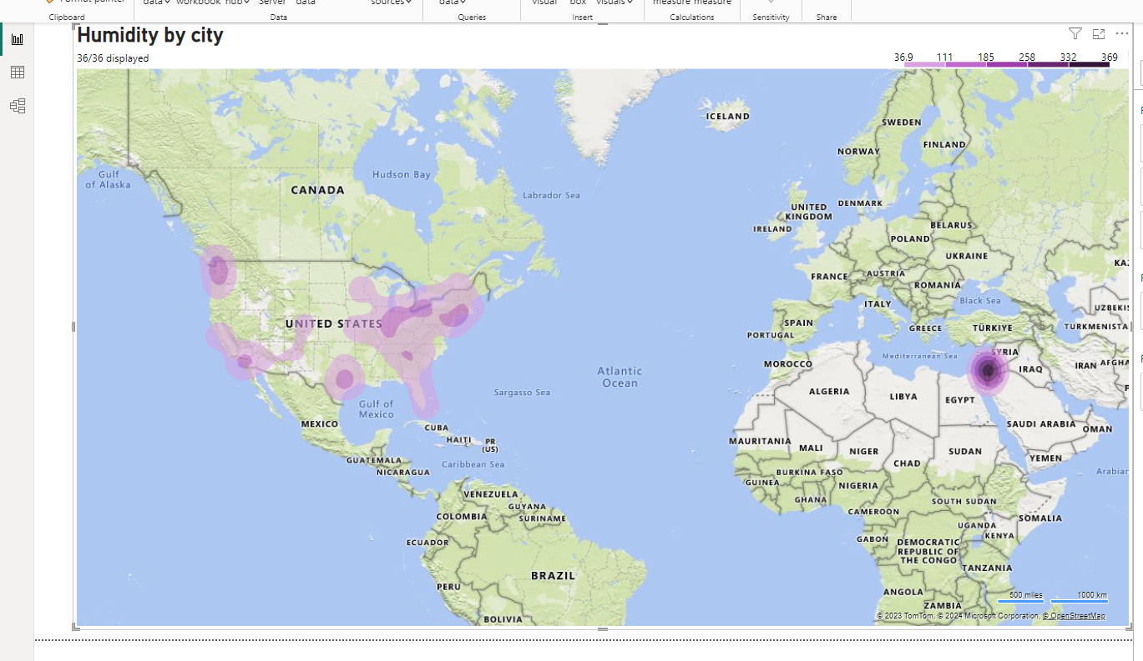
.Create a line chart in Power BI to display the temperature trends over time for a selected city. Highlight extreme temperature events.
5How does humidity vary across different cities? Generate a heatmap in Power BI to visualize this variation

Slide 19
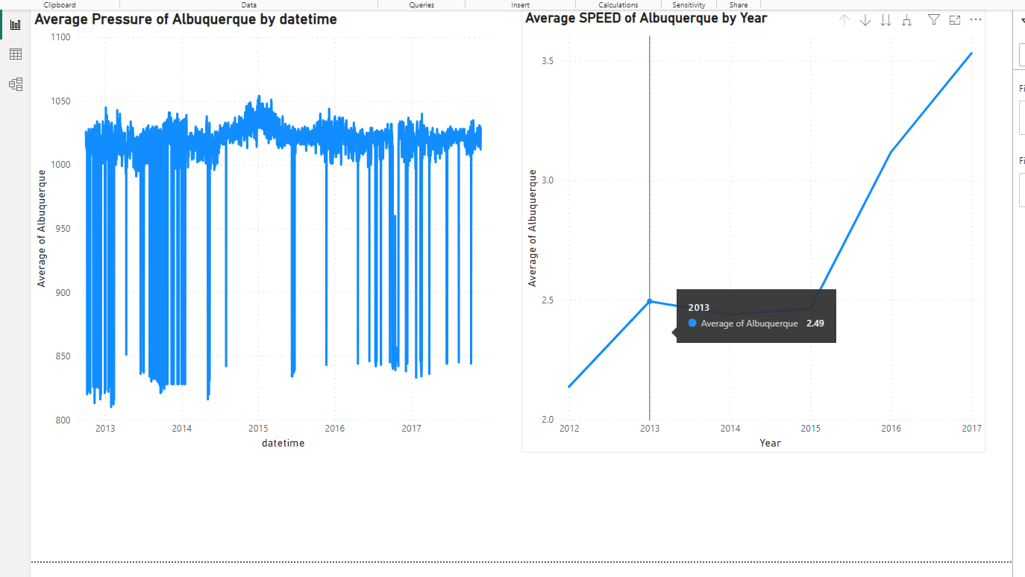
6Can you create a time-series chart in Power BI showing the relationship between wind speed and air pressure for a specific city?

Slide 20
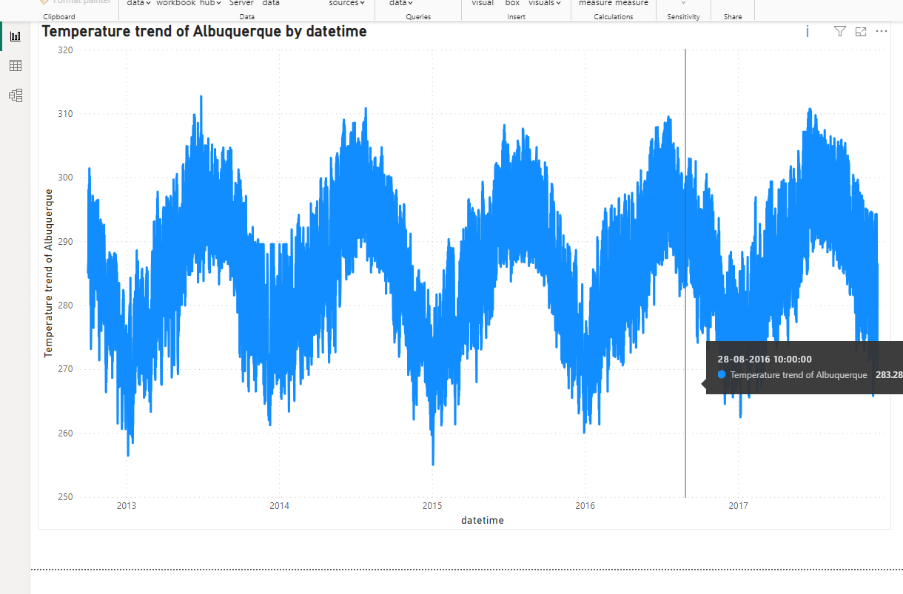
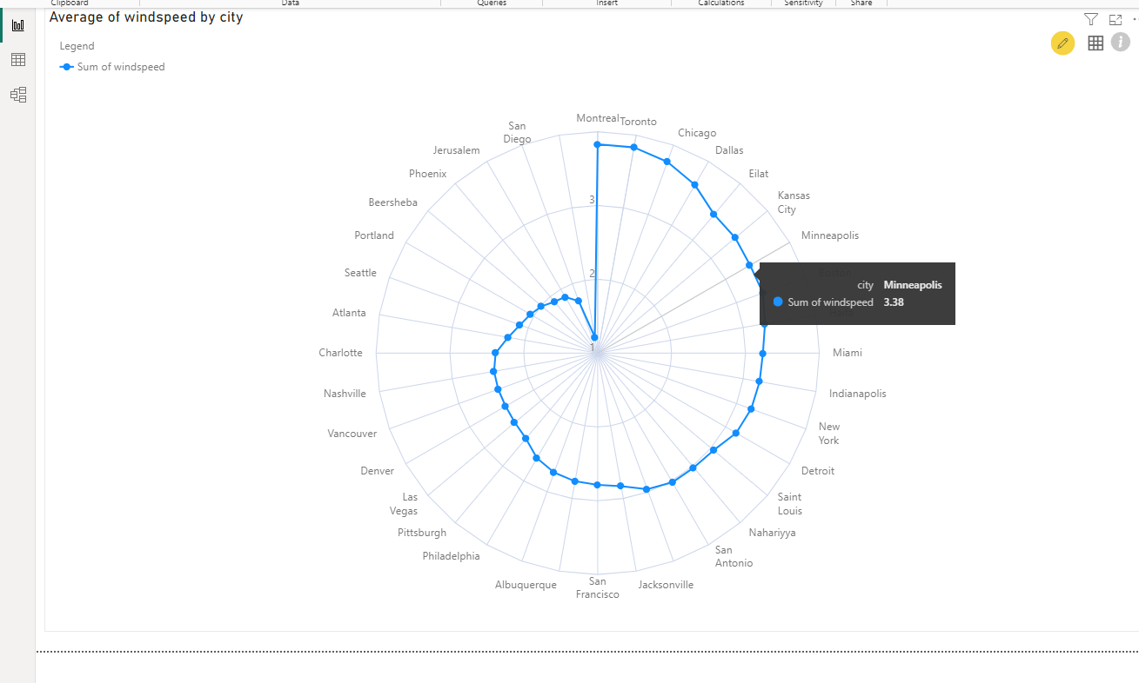
7Create a time-series line chart in Power BI to show the overall temperature trends over the entire dataset
9.How does the wind speed change over the course of a day? Create a radial chart in Power BI to represent this

Slide 21
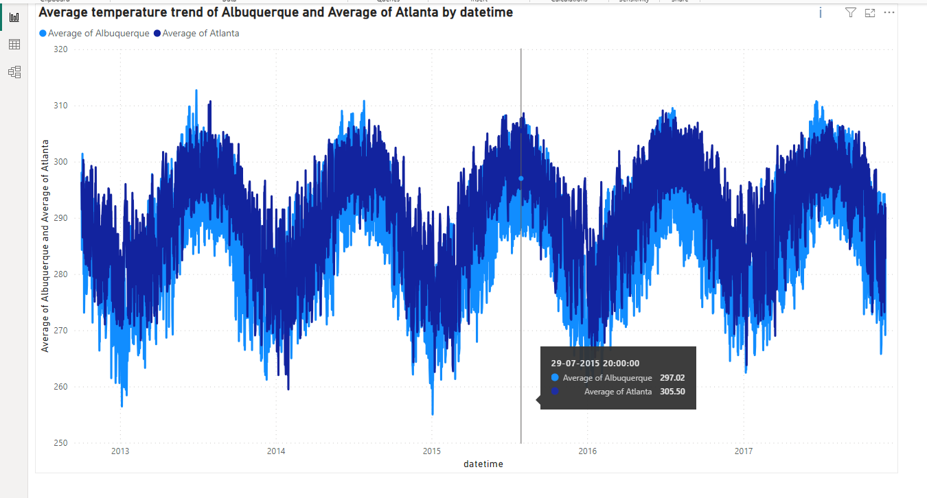
10Create a Power BI chart comparing the temperature variations between two selected cities over a specific timeframe

Slide 22
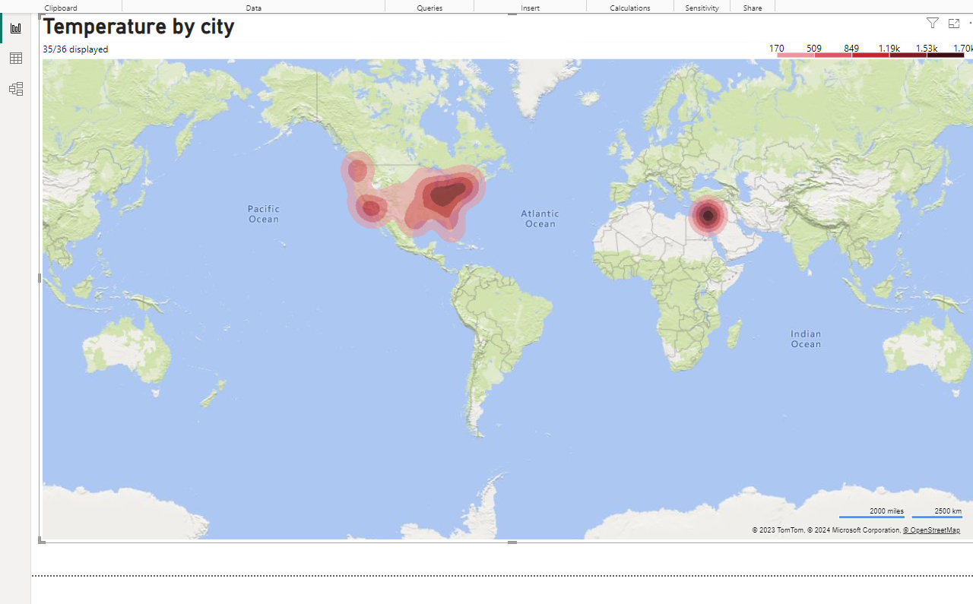
11Can you build a heatmap in Power BI to show the temperature ranges for cities across different countries?

Slide 23
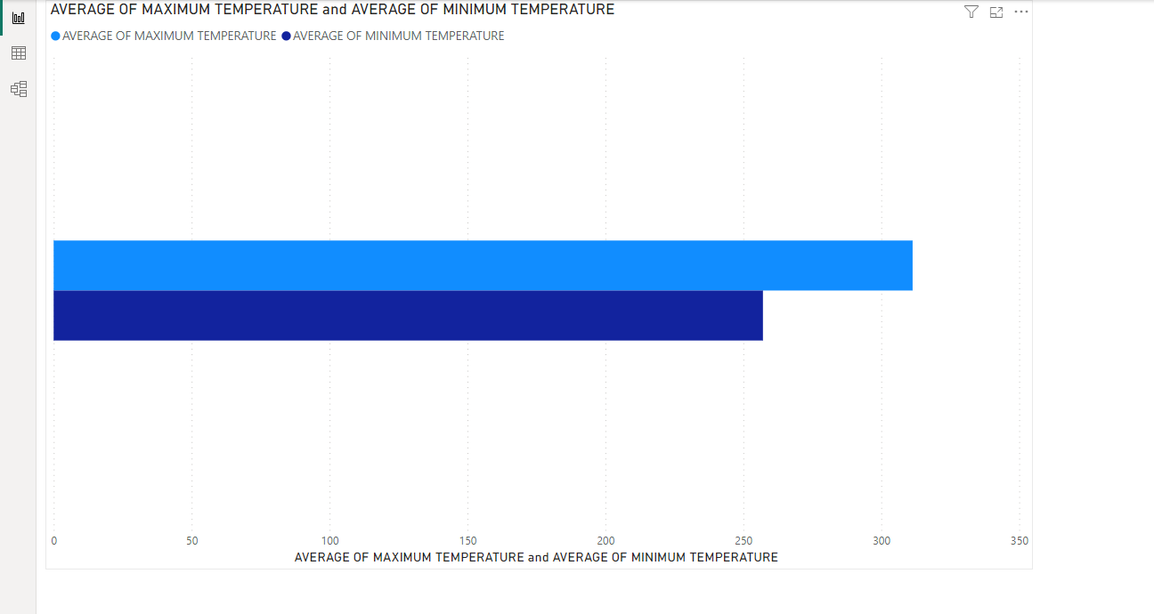
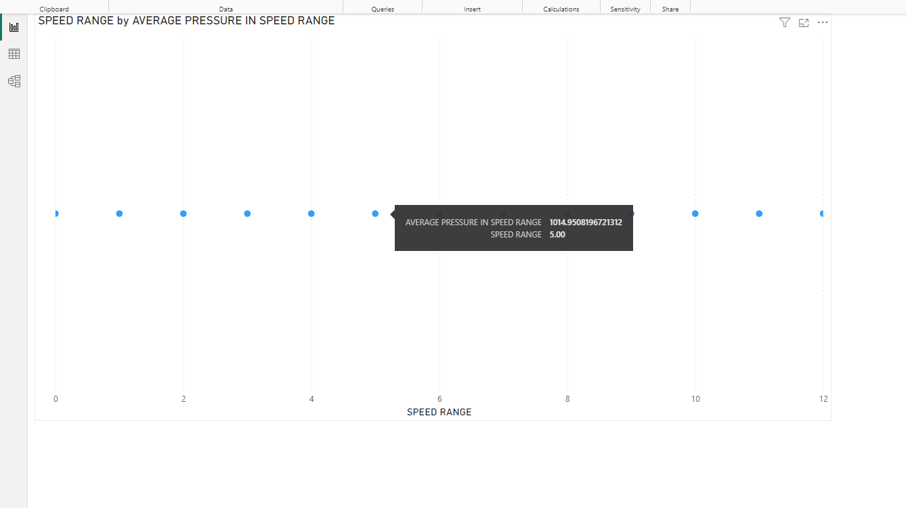
12.Create a bar chart in Power BI to highlight cities with the highest and lowest average temperatures in the dataset
15Create a Power BI scatter plot to show the relationship between wind speed and air pressure for a specific city.

Slide 24
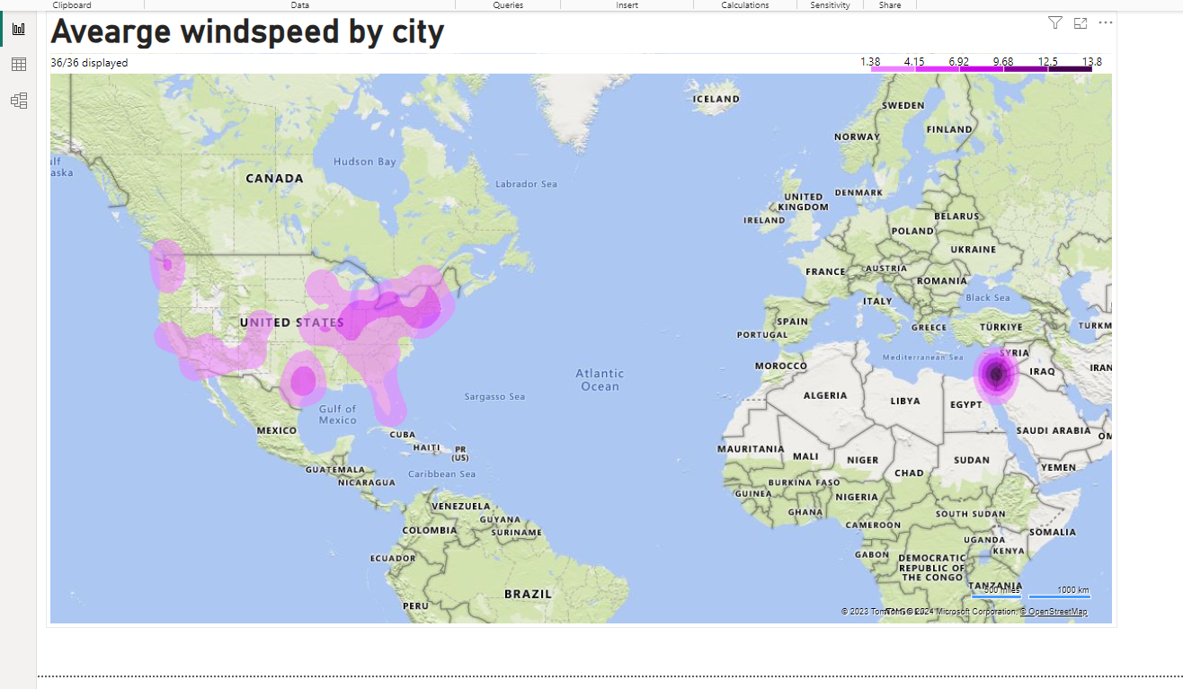
14.Can you generate a Power BI heatmap illustrating the average wind speeds across cities for different months of the year?

Slide 25
THANK YOU

